Slide 1
Home Energy Efficiency & Renewable Energy Options
Bill Byrom
North Texas Renewable Energy Group
Meeting Program Coordinator
solar@byrom.net

Slide 2
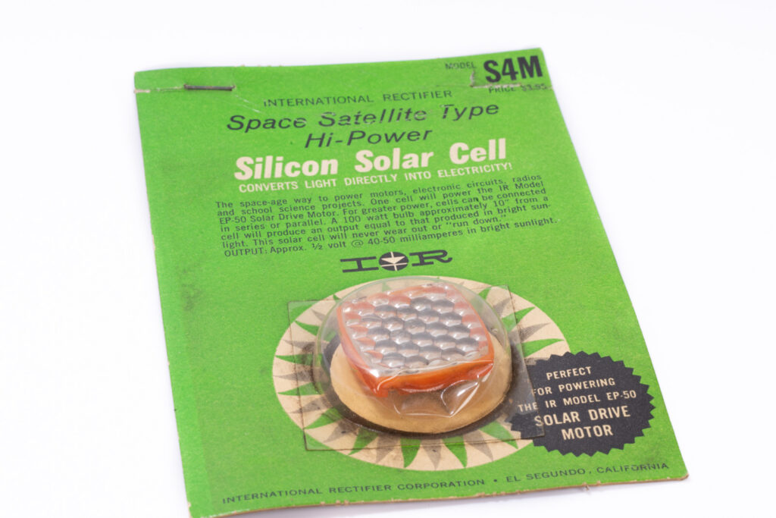
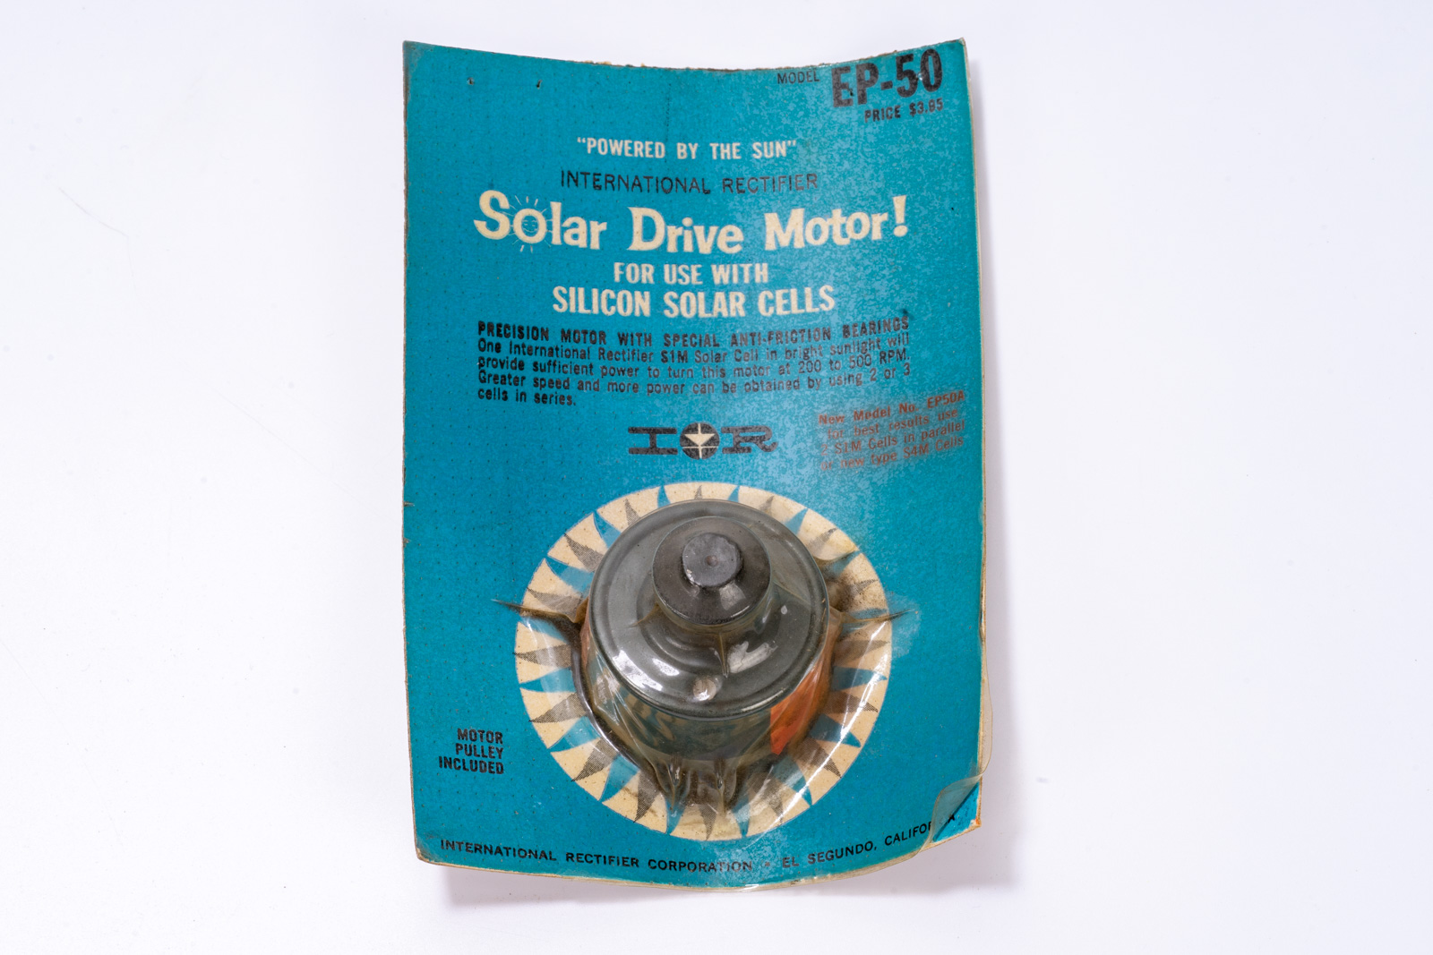
Early Solar Cells
My first solar cell was an Internattional Rectifier model S4M, which I used while I was an elementary school student 60 years ago (about 1965). I also owned an EP-50 small DC motor which spun rapidly when powerd by the solar cell in direct sunlight. Some of the first solar cells were used to power satellites.

Slide 3
Agenda
Why is energy use in housing so important?
Building energy efficiency
Sources of energy used in homes
Renewable vs non-renewable energy sources
Renewable energy supplied from the grid
Home solar power systems
HVAC and water heating systems
Charging electric vehicles at home
Example of my zero net energy home in Irving

Slide 4
Energy Use Affects the Quality of Life
Energy is expensive – improving efficiency can help your budget
Human health and comfort require both heating and cooling of our homes and vehicles in our North Texas climate
Air pollution due to energy use in our homes and vehicles can lead to discomfort and medical issues such as allergies and cardiovascular disease
The location of the air pollution can be inside the home, local emissions from a vehicle tailpipe, when refilling a fossil fueled vehicle at a gas station, or outside in the general environment
Some home HVAC systems and autos can generate noise pollution
Global warming & other societal issues are directly affected by energy use

Slide 5
Ozone Air Pollution in North Texas
From the Dallas Morning News earlier this year: Long ozone season starts up in D-FW. Increase in pollutant raises air quality concern for many until November. By MIRIAM FAUZIA, Staff Writer. Ozone season is upon North Texas, meaning air quality will be top of mind for some residents. The season — which marks the window when there’s a greater risk of harmful amounts of ground-level ozone — is actually the majority of the year in Dallas-Fort Worth, lasting from March 1 to November 30.
Ozone is a gas formed in the atmosphere when three atoms of oxygen combine, according to the Texas Commission on Environmental Quality.
While overall air quality has improved over the past few decades, ozone levels continue to exceed federal standards.

Slide 6
Building Energy Efficiency
HVAC heating and cooling of buildings depends on isolating the indoor environment from the outdoor environment
One important area where energy can be wasted is air leakage around door and window gaskets as well as other locations
Energy can also leak directly through windows and doors
Quality insulation of the building envelope is also important, including walls, ceilings, roofs, and flooring
Many technologies with varying efficiencies are available for heating and cooling the air inside a building – more on this later

Slide 7
Energy Use in a Home
The greatest use of energy in a house is usually the HVAC and water heating systems
But appliances also use a significant amount of energy. These include a refrigerator, oven, range top, dishwasher, washing machine, and clothes dryer. Televisions and other electronic devices can also use a significant amount of energy if they are left on for many hours.
Lighting and fans also consume quite a bit of energy, especially if used for long periods. LED lighting is much better than incandescent.
Natural gas appliances burn methane and release air pollution and greenhouse gases. Trace gases such as benzine are also released.

Slide 8
Sources Of Energy For Home Use (grid/local)
Electric grid supplied renewable energy (solar, wind, hydroelectric)
Electric grid supplied nuclear energy
Electric grid supplied fossil fueled energy (methane gas, coal, oil)
District or co-generation energy (not available in most areas)
Natural gas via pipes (methane) and oil in some northern states
Local home solar panels (and batteries)
Vehicle to house transfer from electric vehicle (coming soon!)
Heating or electric generator using methane, propane, or gasoline

Slide 9
Renewable vs Non-Renewable Energy Sources
Renewable energy sources (solar, wind, and hydroelectric) are essentially non-polluting and rely on energy provided in our current era from the sun
Non-Renewable fossil energy sources (methane, oil, propane) normally require burning of fuels which were created using energy from the sun in previous eras, producing air and often other pollution, including greenhouse gases
Nuclear energy is technically non-renewable, but does not produce air pollution. But it does produce radioactive waste and thermal (heat) pollution

Slide 10
Renewable Energy Supplied From The Grid
In most areas of North Texas you can purchase electricity produced by solar farms and/or wind farms
Solar farms are photovoltaic (PV) solar power plants. Light from the sun directly produces electric power using solar cells mounted on panels. Large solar farms are usually in areas with fewer clouds and moderate to low land cost.
Wind farms are in areas which tend to receive a lot of wind, often at night. These are often found in areas west and northwest of North Texas, as well as in Oklahoma.
Hydroelectric power is not prevalent in North Texas.

Slide 11
Home Solar Power Systems
Solar panels can be mounted on a roof, carport, or a ground mount
Power is usually generated only when the solar panel receives direct sunlight illumination. Some solar panels are bifacial and can also generate power from the rear of the panel.
Batteries are often added to the system for use at night.
The output of a solar panel has a negative temperature coefficient. For example, heating a solar panel by 18 degrees F (10 degrees C) might reduce the power output by 3.4%.
The output is greatest when sunlight falls normal to the panel surface. So the output varies through the day and during different seasons.

Slide 12
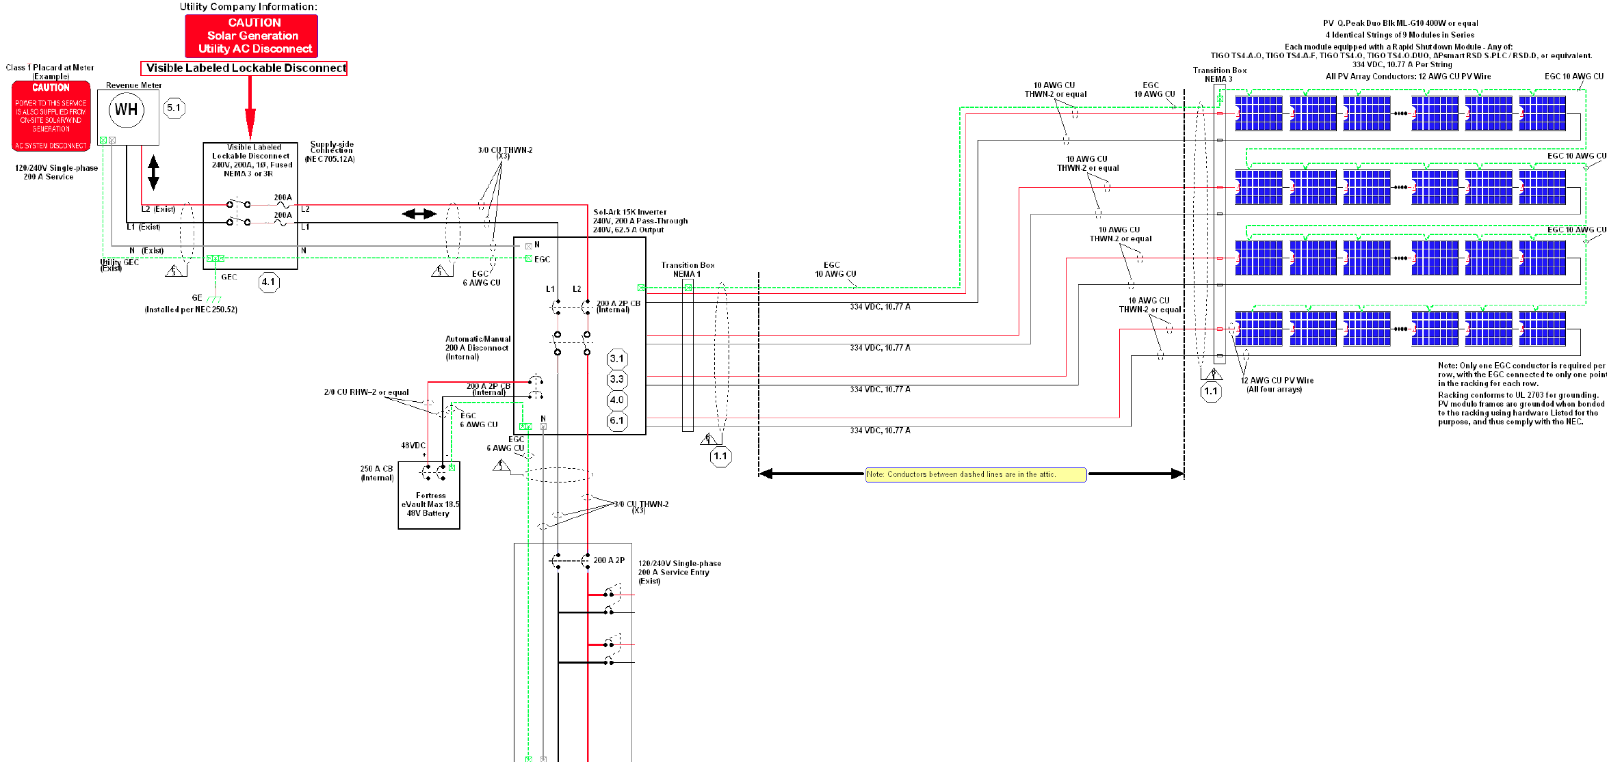
Solar Power System Schematic

Slide 13
Sun Angle Effect on Solar Power System
The Earth’s axis is tilted at about 23.5 degrees to our solar orbit, producing differing maximum sun angles to the horizon through the year at our North Texas latitude of about 32.8 degrees north:
  57.2 degrees sun height at vernal (March 20) and autumnal (Sept 22) equinox
  33.8 degrees sun height at winter (Dec 21) solstice
  80.6 degrees sun height at summer (June 20) solstice
A south-facing roof with solar panels angled at 30 degrees produces maximum output at a sun height of (90-30)=60 degrees. This is close to optimum for our latitude. The power output follows a modified cosine curve each day. Shading from trees can modify the production curve.
The maximum peak power from a 30 degree tilt should be near the equinoxes, when the peak sunlight is directly orthogonal to the panels. Energy production during the summer is increased due to the long days, but the panel output is reduced by 0.34% per degree C. The output in the winter is reduced due to shorter days. Thick clouds reduce the output significantly.

Slide 14
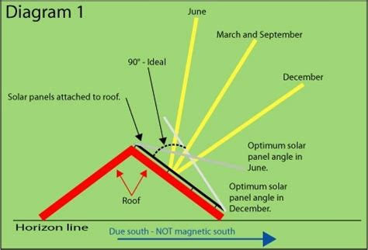
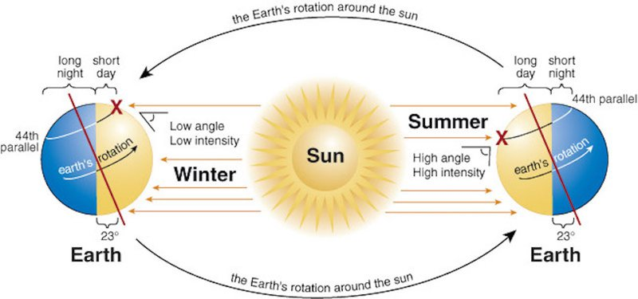
The axis of Earth is tilted 23.5 degrees to our solar orbit
The latitude of the DFW area is about 32.8 degrees North
This results in an optimum solar panel tilt of about 30 degrees
At the vernal (March 20) and autumn (Sept 22) equinox the sun will be perpendicular to the solar panel at mid-day

Slide 15
Operation of a Solar Power System
PV (photovoltaic) power from solar panels can be used to advantage in several ways:
  If the house load (including EV charging) is higher than the PV output, the solar power reduces the import (purchase) of grid energy. Small systems with only a few solar panels can significantly reduce their energy expense. This is true even if the system is not set up to sell energy to the grid.
  If the PV output exceeds the house load and the system is set up for bidirectional metering, the system can sell power to the grid. Unfortunately, current REP plans typically pay much less for grid export than for import.
  If the system has a large battery, the house may be able to operate all (or most) of the night using the battery, then recharge the following day using solar power. This is called load shifting and can reduce your bill.

Slide 16
PV Solar DC to AC Inverter
Solar panels provide DC voltage, but homes are wired for AC
There are two basic inverter systems
  DC Coupling: The solar panels are placed in one or more series strings which drive a string inverter. This system produces high voltage DC on the roof and usually has one inverter mounted in the house (or outside) near the main AC system panel.
  AC Coupling: A small inverter is mounted on the rear of each solar panel. 240 VAC is usually run to the roof and each panel Indi dually drives the house AC system.
  Fast shutoff features are usually required to allow emergency responders to get on the roof without danger from hot wiring.
  Optimizer modules are often used to improve efficiency when some solar panels are shaded. Fast shutoff features are available with some optimizers.

Slide 17
Operating Off-Grid
If off-grid operation of a PV solar power system is planned, there must be a way to reliably and rapidly disconnect the home AC wiring from the grid during a grid failure. The home can not be allowed to feed any power into the grid until the grid is reliably up again.
Low cost solar systems are often AC coupled, with small inverters on the roof. Many of these systems can not be operated off-grid or using battery power. When the grid fails, there is no power in the house and the PV panels are disabled. The solar panels only reduce cost during daylight.
DC coupled string inverter systems often include a high current automatic AC grid disconnect switch. This allows the PV solar power system (and any available battery) to power the house during a grid failure.

Slide 18
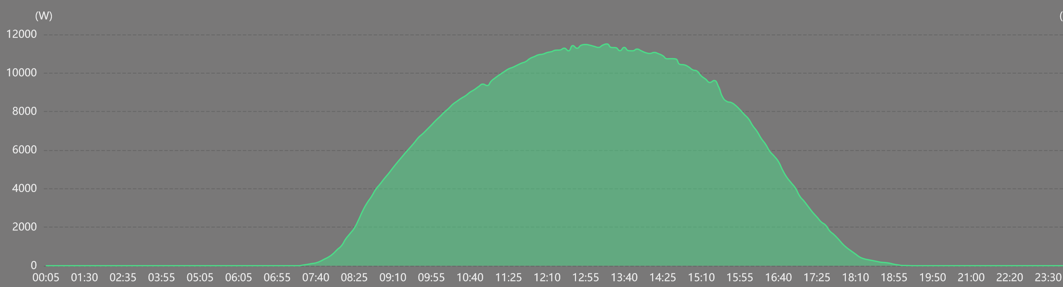
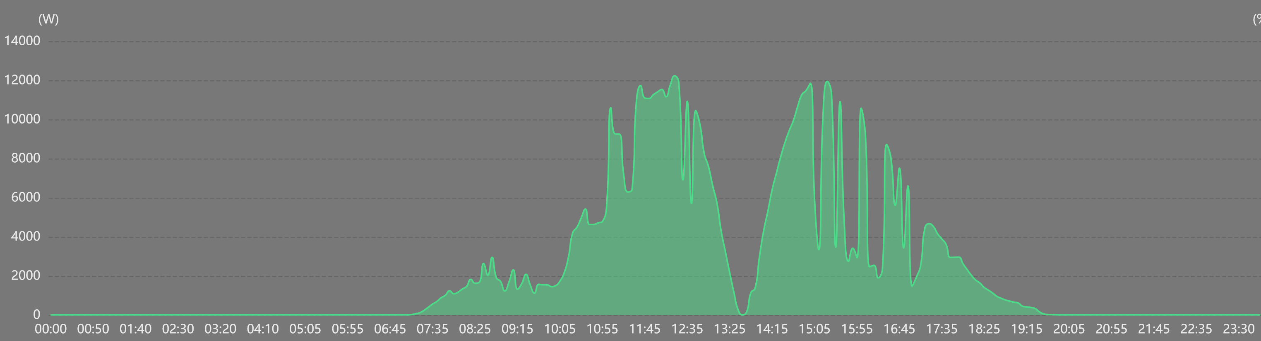
PV Generation on Clear and Cloudy Days
Wed Oct 1, 2024
Mon April 8, 2024

Slide 19
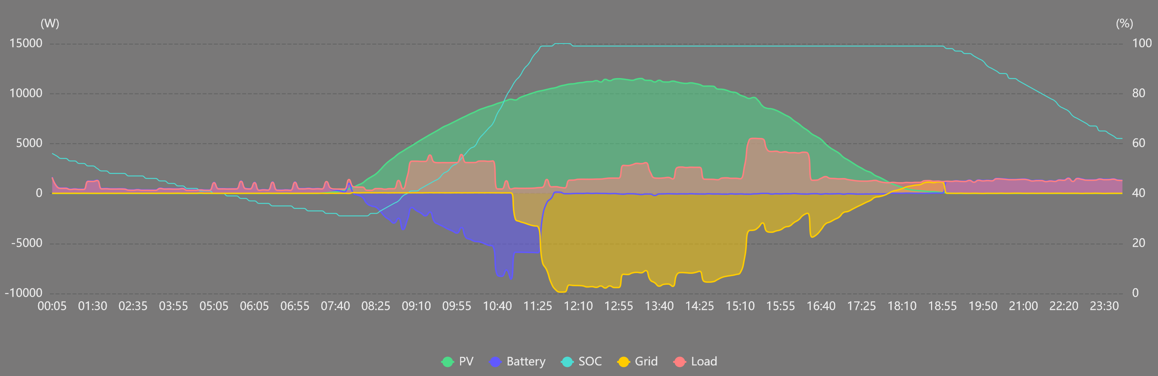
Load Shifting Using ESS Battery (BESS)
My Fortress Power ESS battery can power my house for most or all of the night (depending on temperature and appliance use). The Sol-Ark system inverter is programmed to favor battery use at night. As soon as the sun rises the next morning, the battery is recharged (usually by noon). Energy is exported (sold to the grid) each afternoon and only a small amount of energy is imported (purchased from the grid) before sunup and around sundown. If it’s very cloudy less is exported and more is imported from the grid. Below is an example of a clear day (Oct 1, 2024) with EV charging starting at 9 AM and 3 PM. My dishwasher also ran.

Slide 20
HVAC and Water Heating Systems
HVAC systems heat, ventilate, and air condition a house
Natural gas (methane) can be used to heat air and water, but this generates greenhouse gases and releases pollution from impurities
Resistance electric heat is inefficient, with a COP below 1
Heat pump systems can provide much more efficiency, with a COP of 3 or greater. They can be used for room and water heating, as well as clothes drying.
Heat pumps can be air source or ground source. Ground source heat pumps are much more efficient but require geothermal wells.
Water can also be directly heated using a solar hot water heater.

Slide 21
Charging Electric Vehicles at Home
The best way to charge an EV at home is using a Level 2 (240 VAC) charger. These typically produce up to 10 kW of charging power. So a 70 kWh EV battery could be fully charged in about 7 hours.
If an EV can be charged during sunlight hours, a home solar power system can provide zero incremental cost charging.
In the near future, electric vehicles will provide vehicle to house export of energy from the EV battery to power the house during an emergency. The vehicles and house charging adapters supporting this feature are just arriving on the market now.

Slide 22
Example Zero Energy Building:
Byrom House in Irving
I demolished my old house (which had foundation and other problems) and built a new energy efficient home with a solar power system and ground source heat pump HVAC / water heater.
For normal daily driving I am able to charge my electric vehicle using my home solar power system during sunny days. I’m retired so don’t have long daily work commutes.
My REP (Retail Electric Provider) is Green Mountain Energy. My monthly electric bills are zero (including taxes and fixed fees). I use about half of my solar PV production for powering my house and charging my EV, and sell the remainder back to the grid.

Slide 23
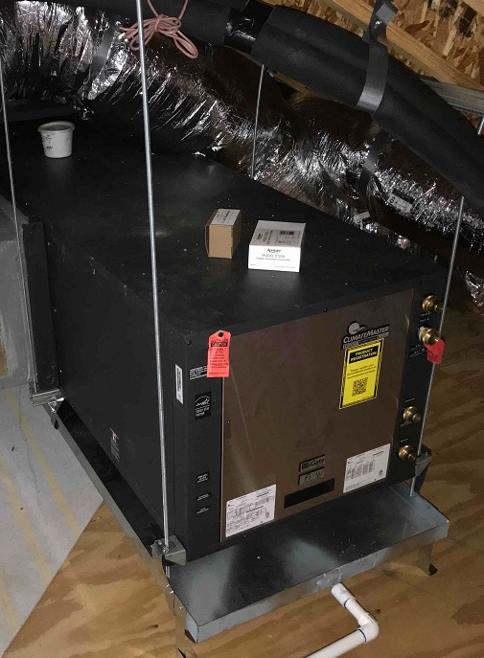
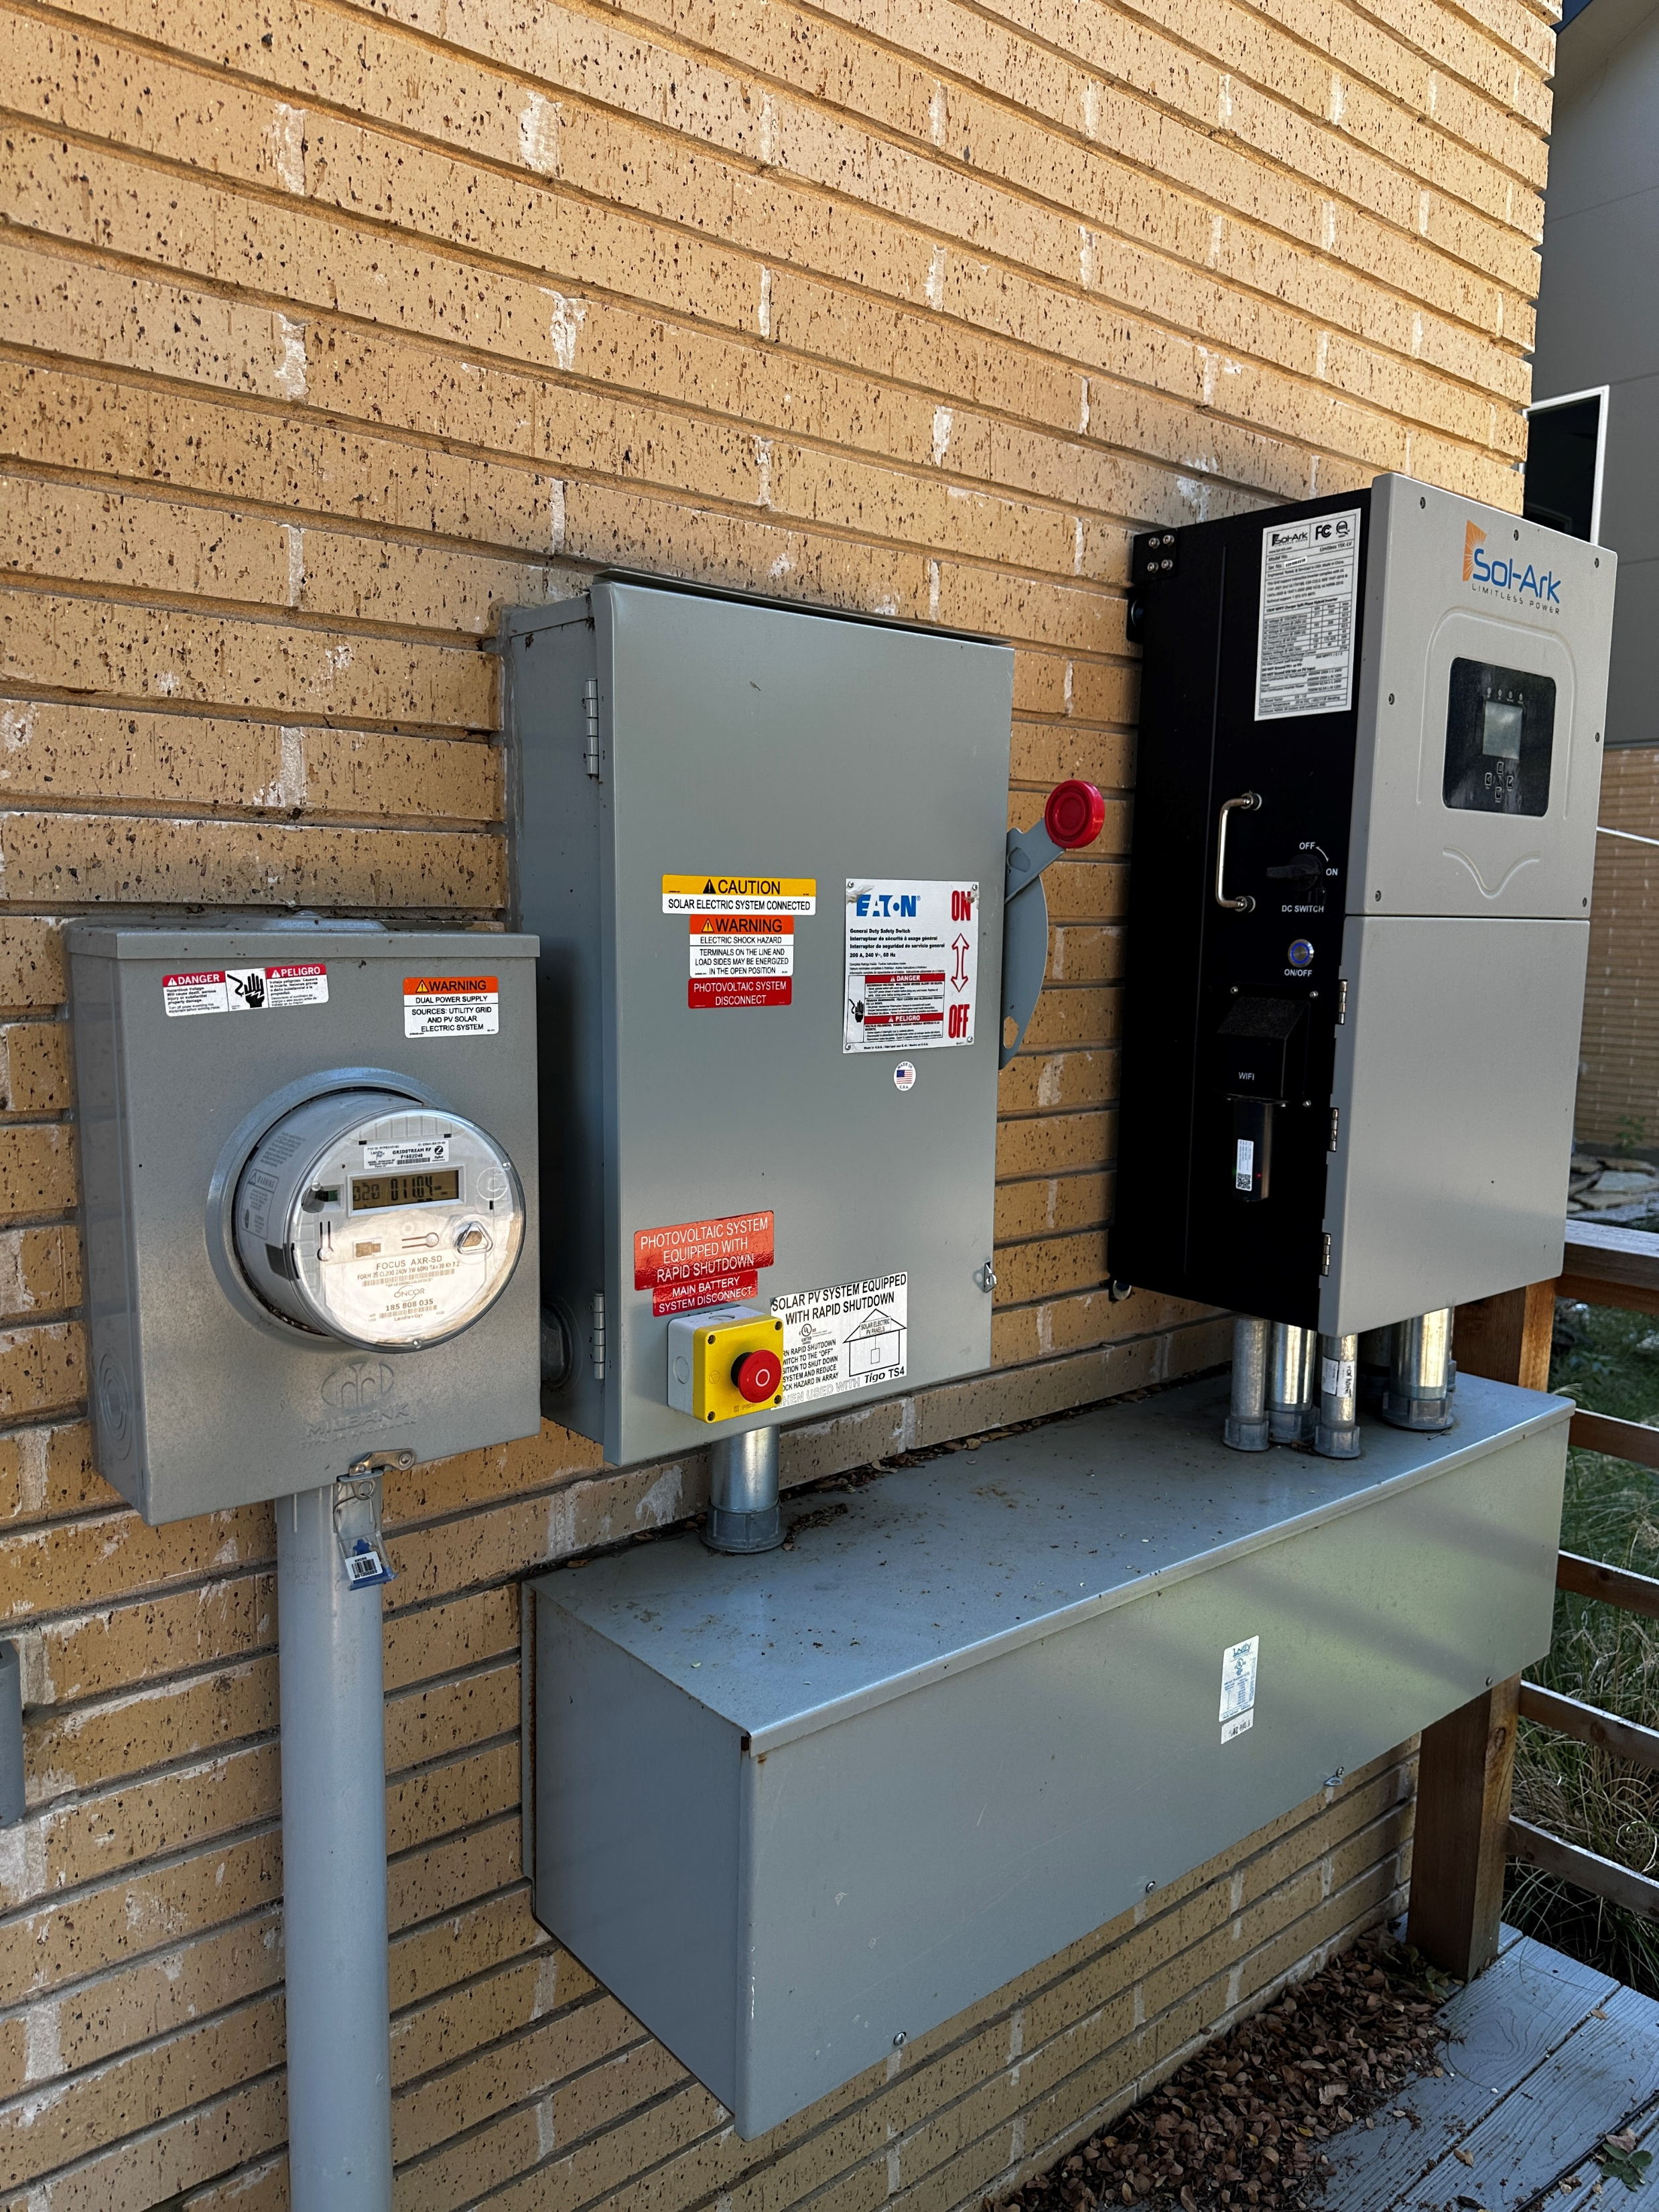
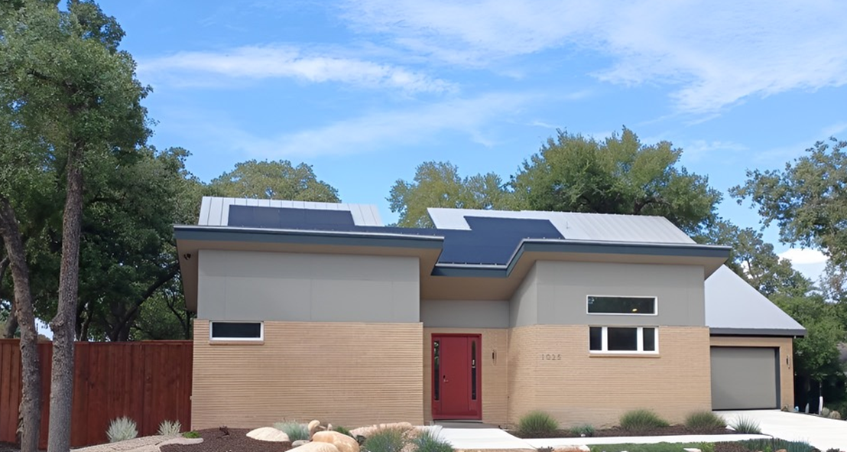
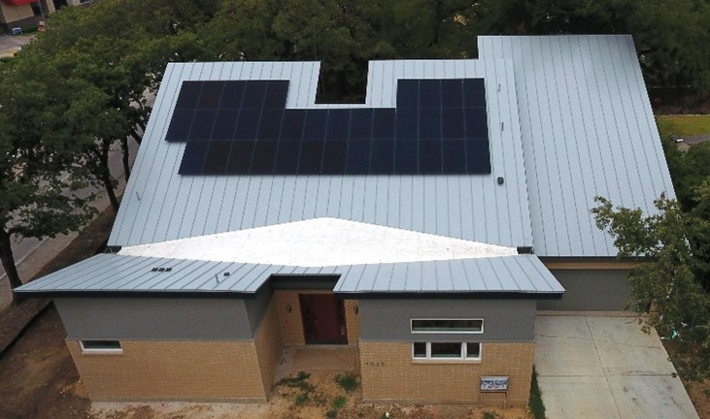
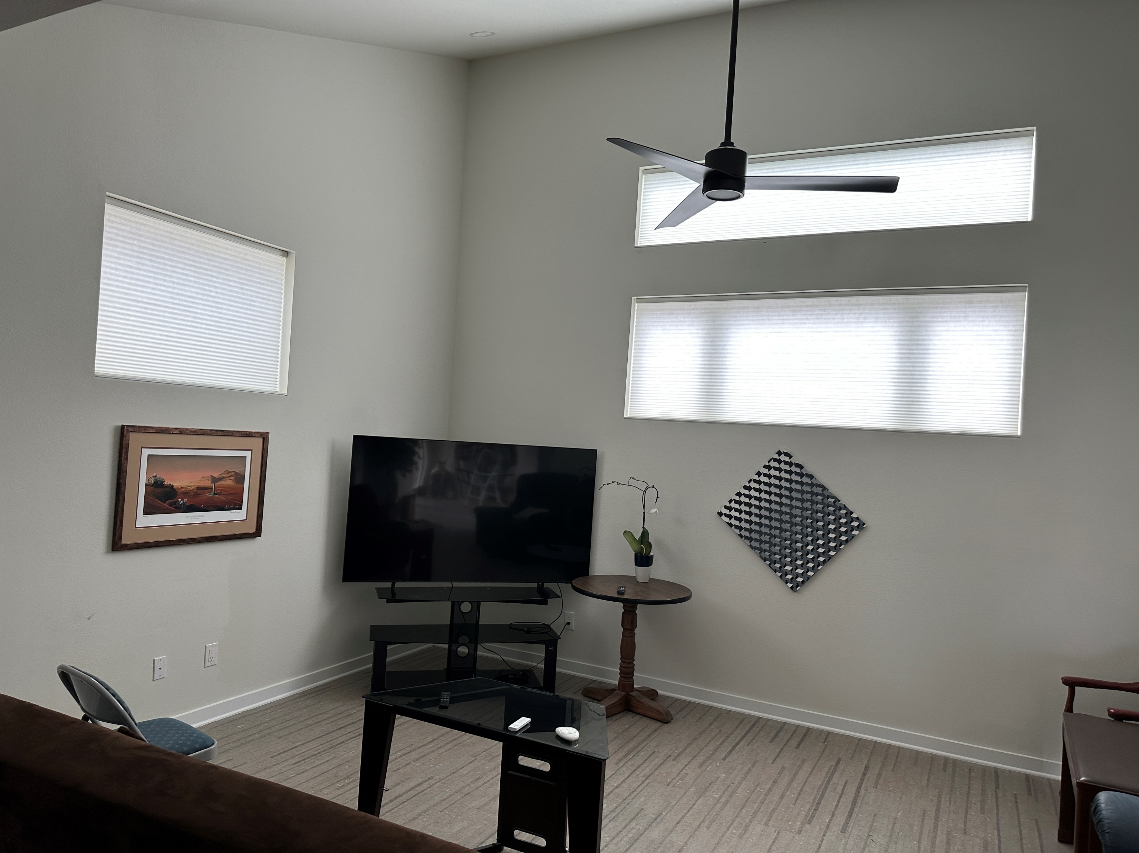
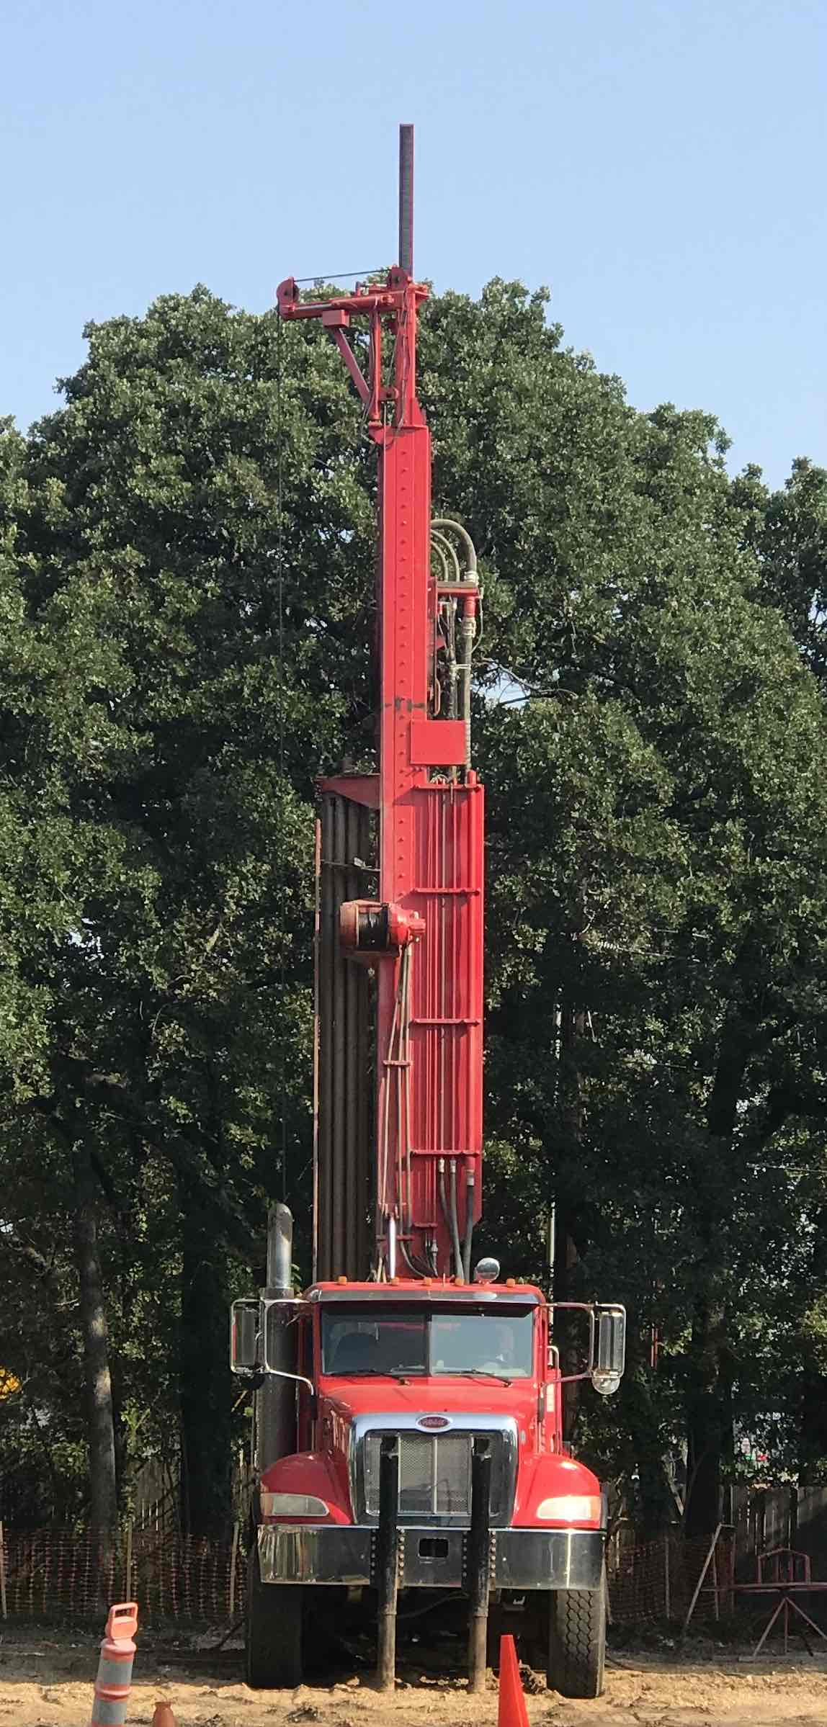

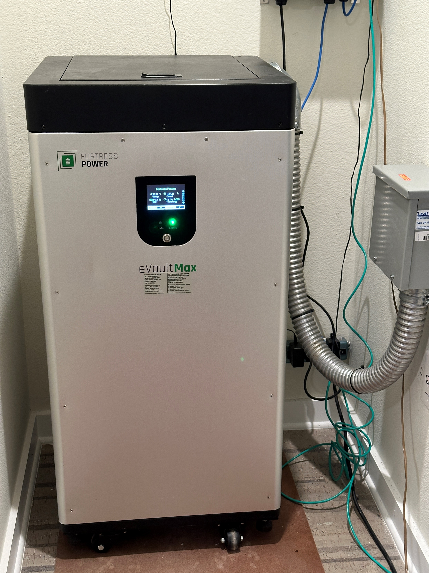
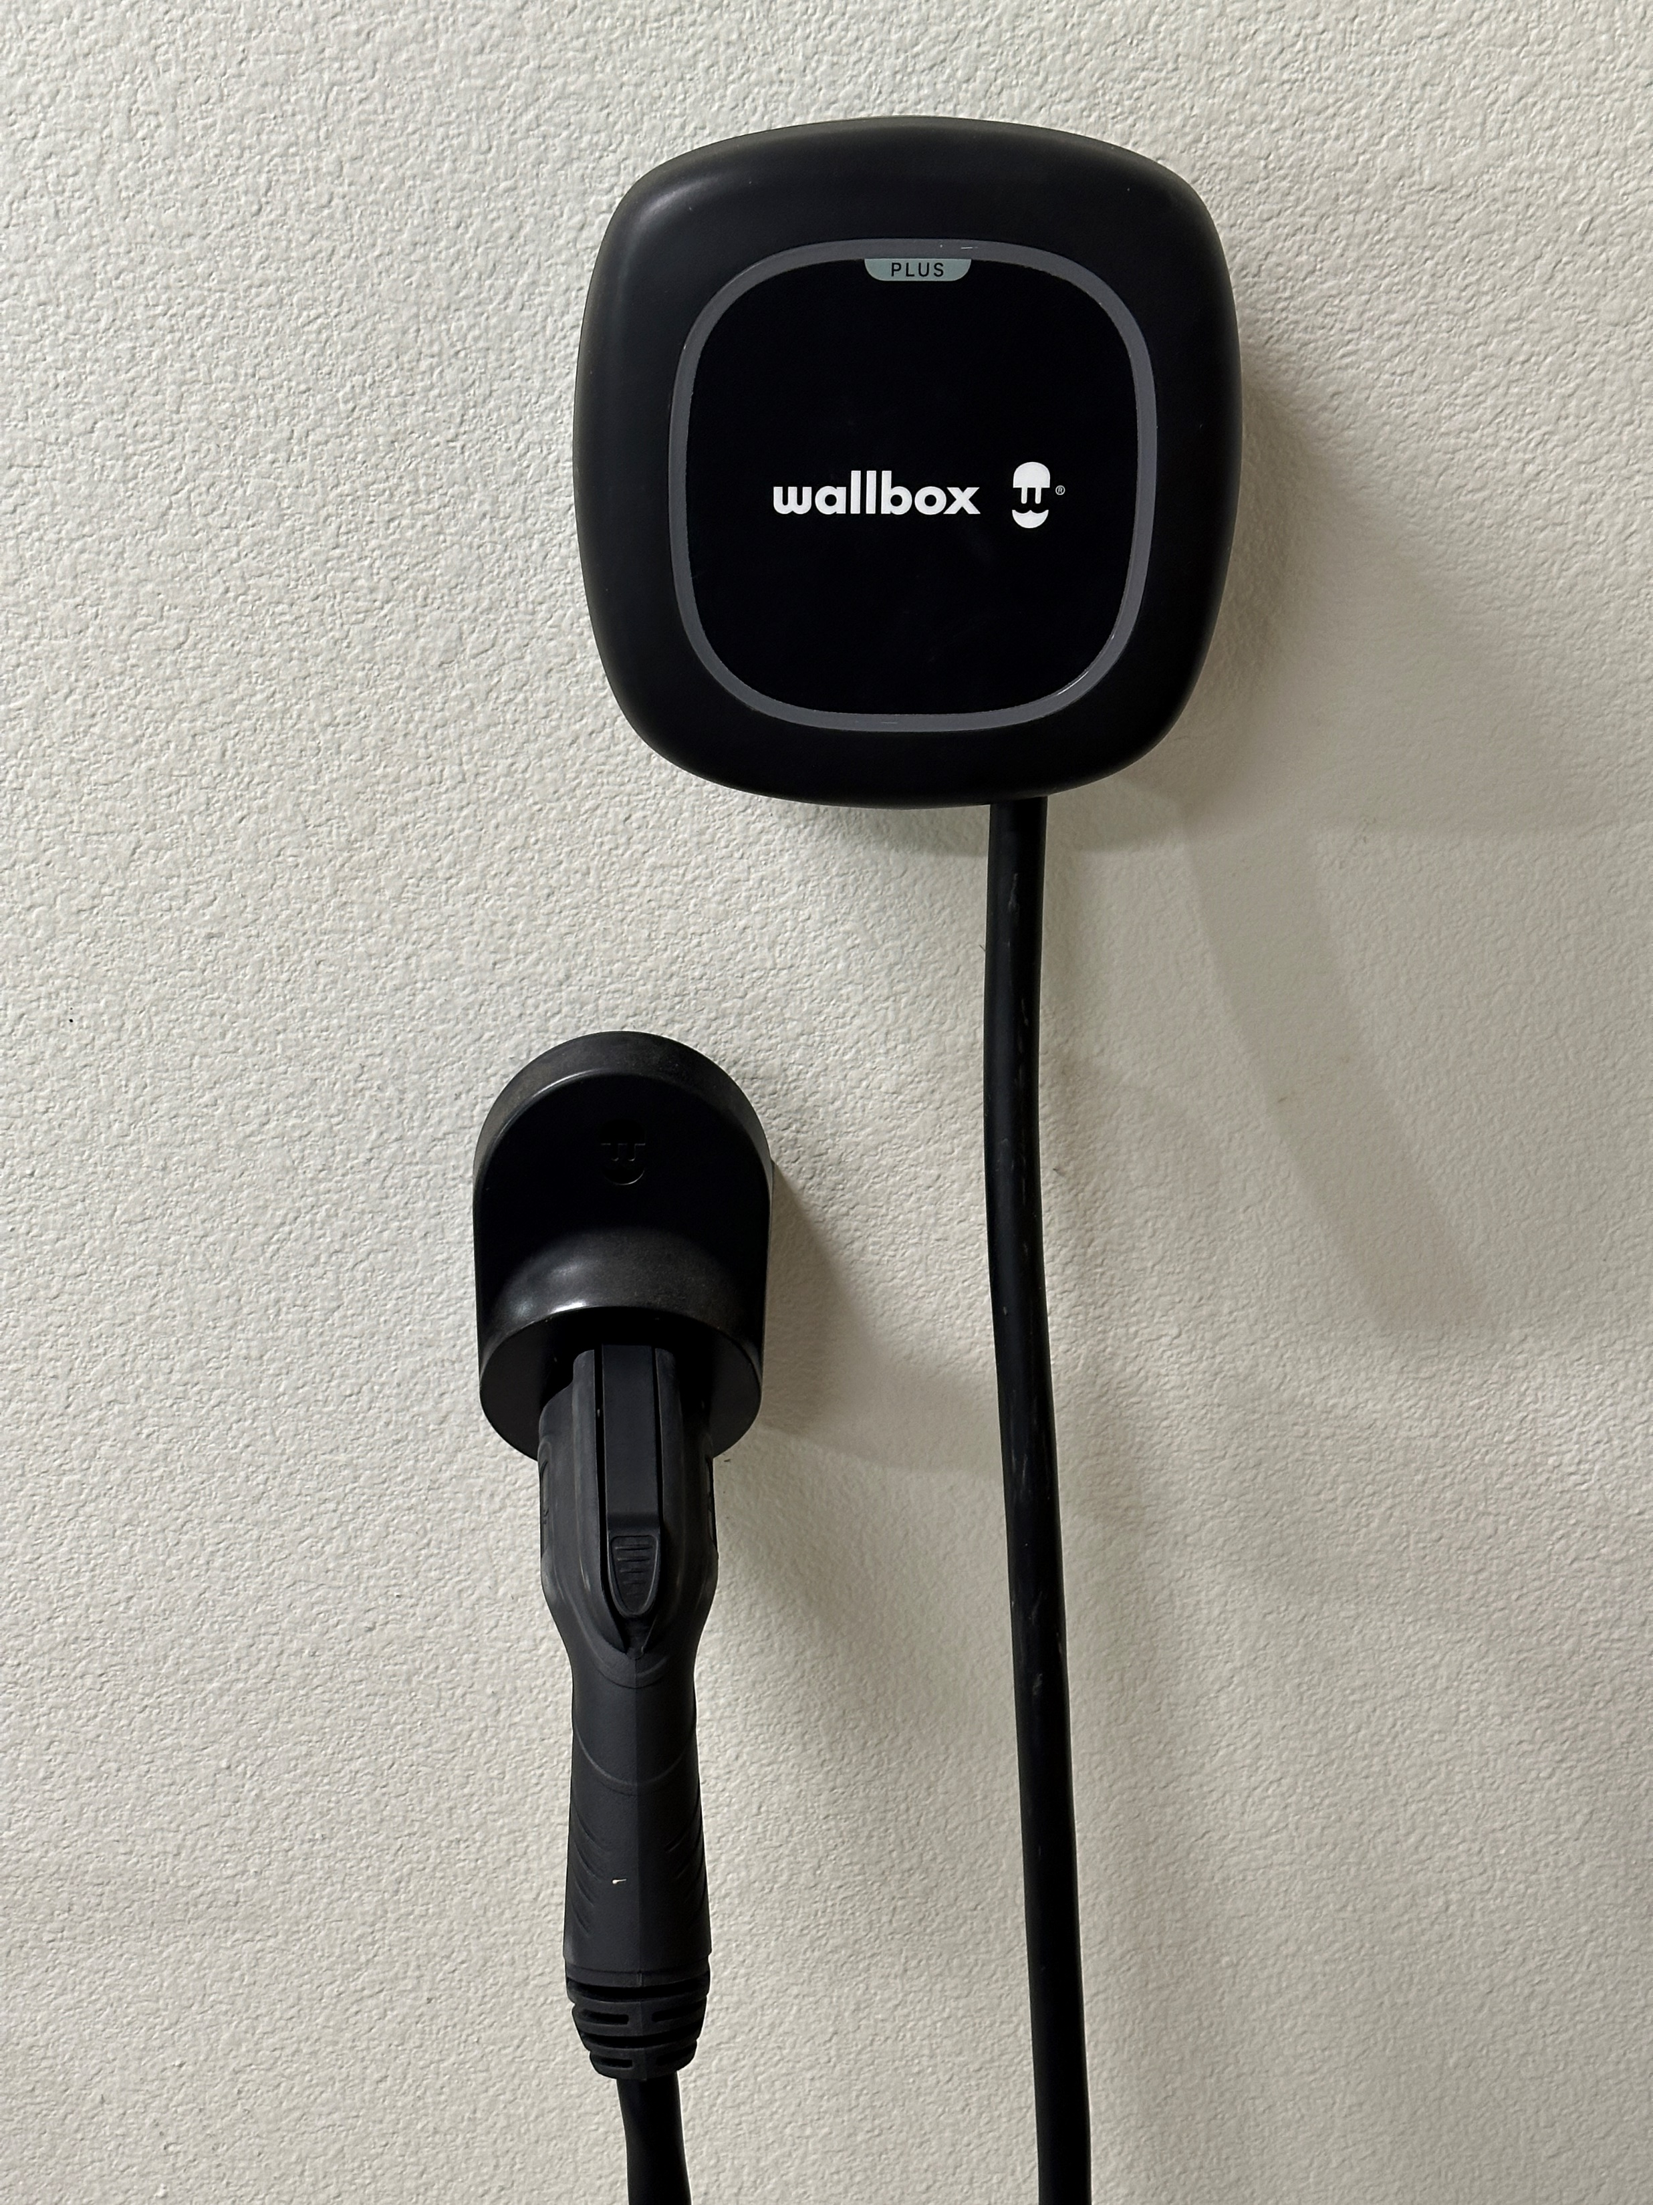
Byrom House Overview

Slide 24
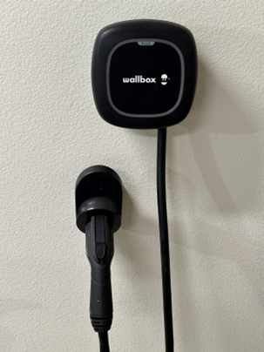
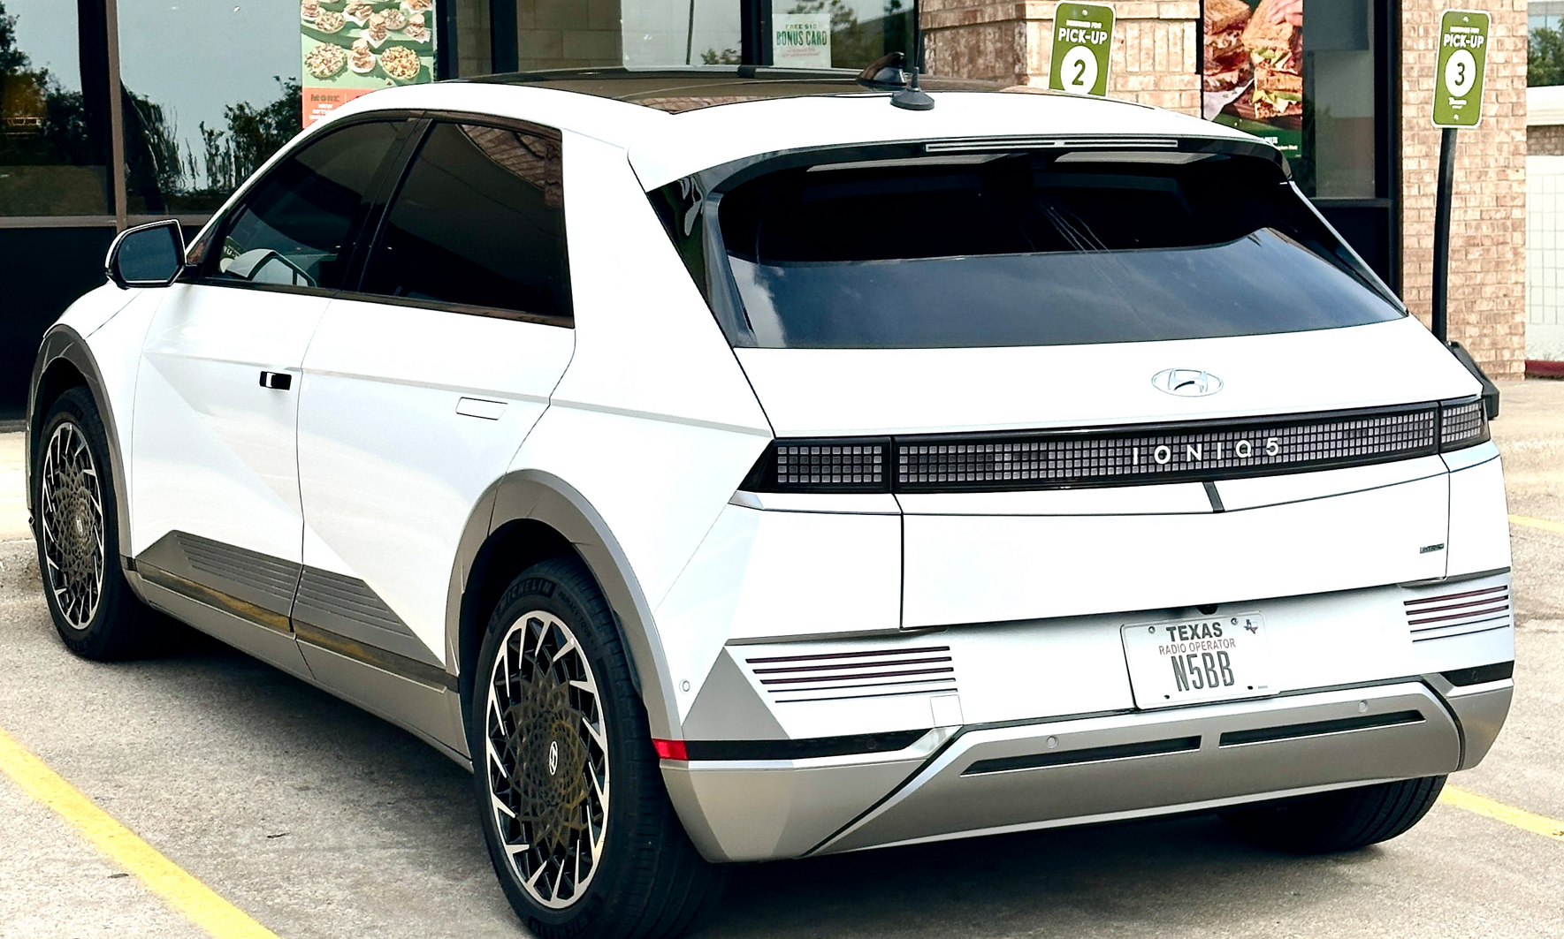
Hyundai IONIQ 5 EV with Wallbox charger
AWD (dual motor, four wheel drive) full electric SUV
Original EV battery and power train warranty: 10 years / 100,000 miles
Battery: 77.4 kWh (about 230 – 260 mile range)
Typical around town mileage: ~ 3 mi/kWh (330 wH/mi)
Charge rate with Wallbox home level 2 charger:
@6A (1.44 kW) = 30 min / 1% charge level
@10A (2.4 kW) = 20 min / 1% charge level
@20A (4.8 kW) = 10 min / 1% charge level
@40A (9.6 kW) = 5 min / 1% charge level
Charge time from 20% to 80% SOC: ~5 hours @40A
Vehicle can also be charged using fast DC charging at
certain EV charging stations (not at home)

Slide 25
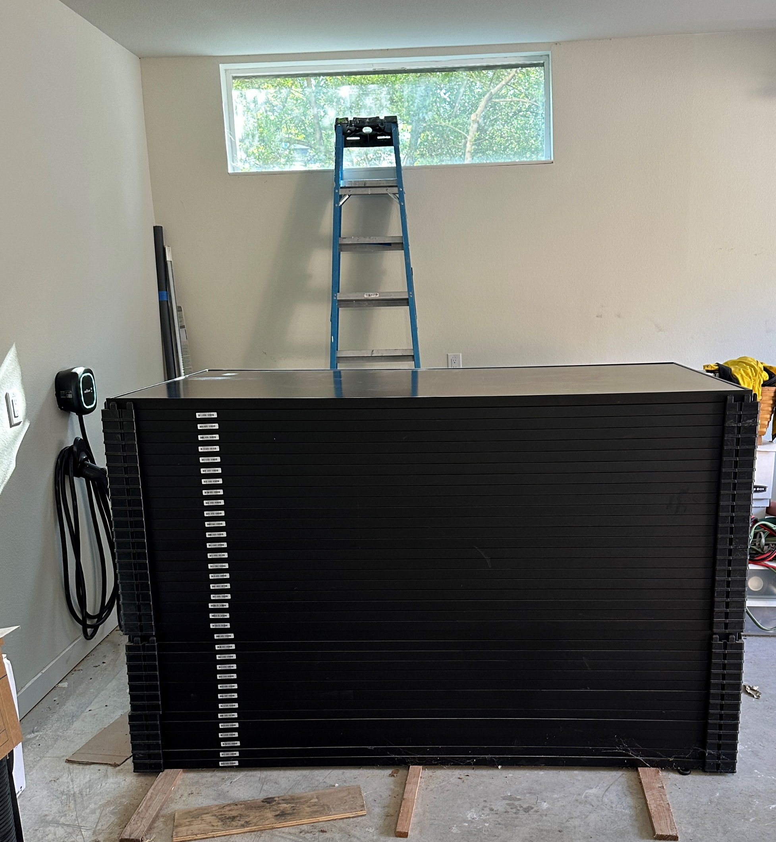
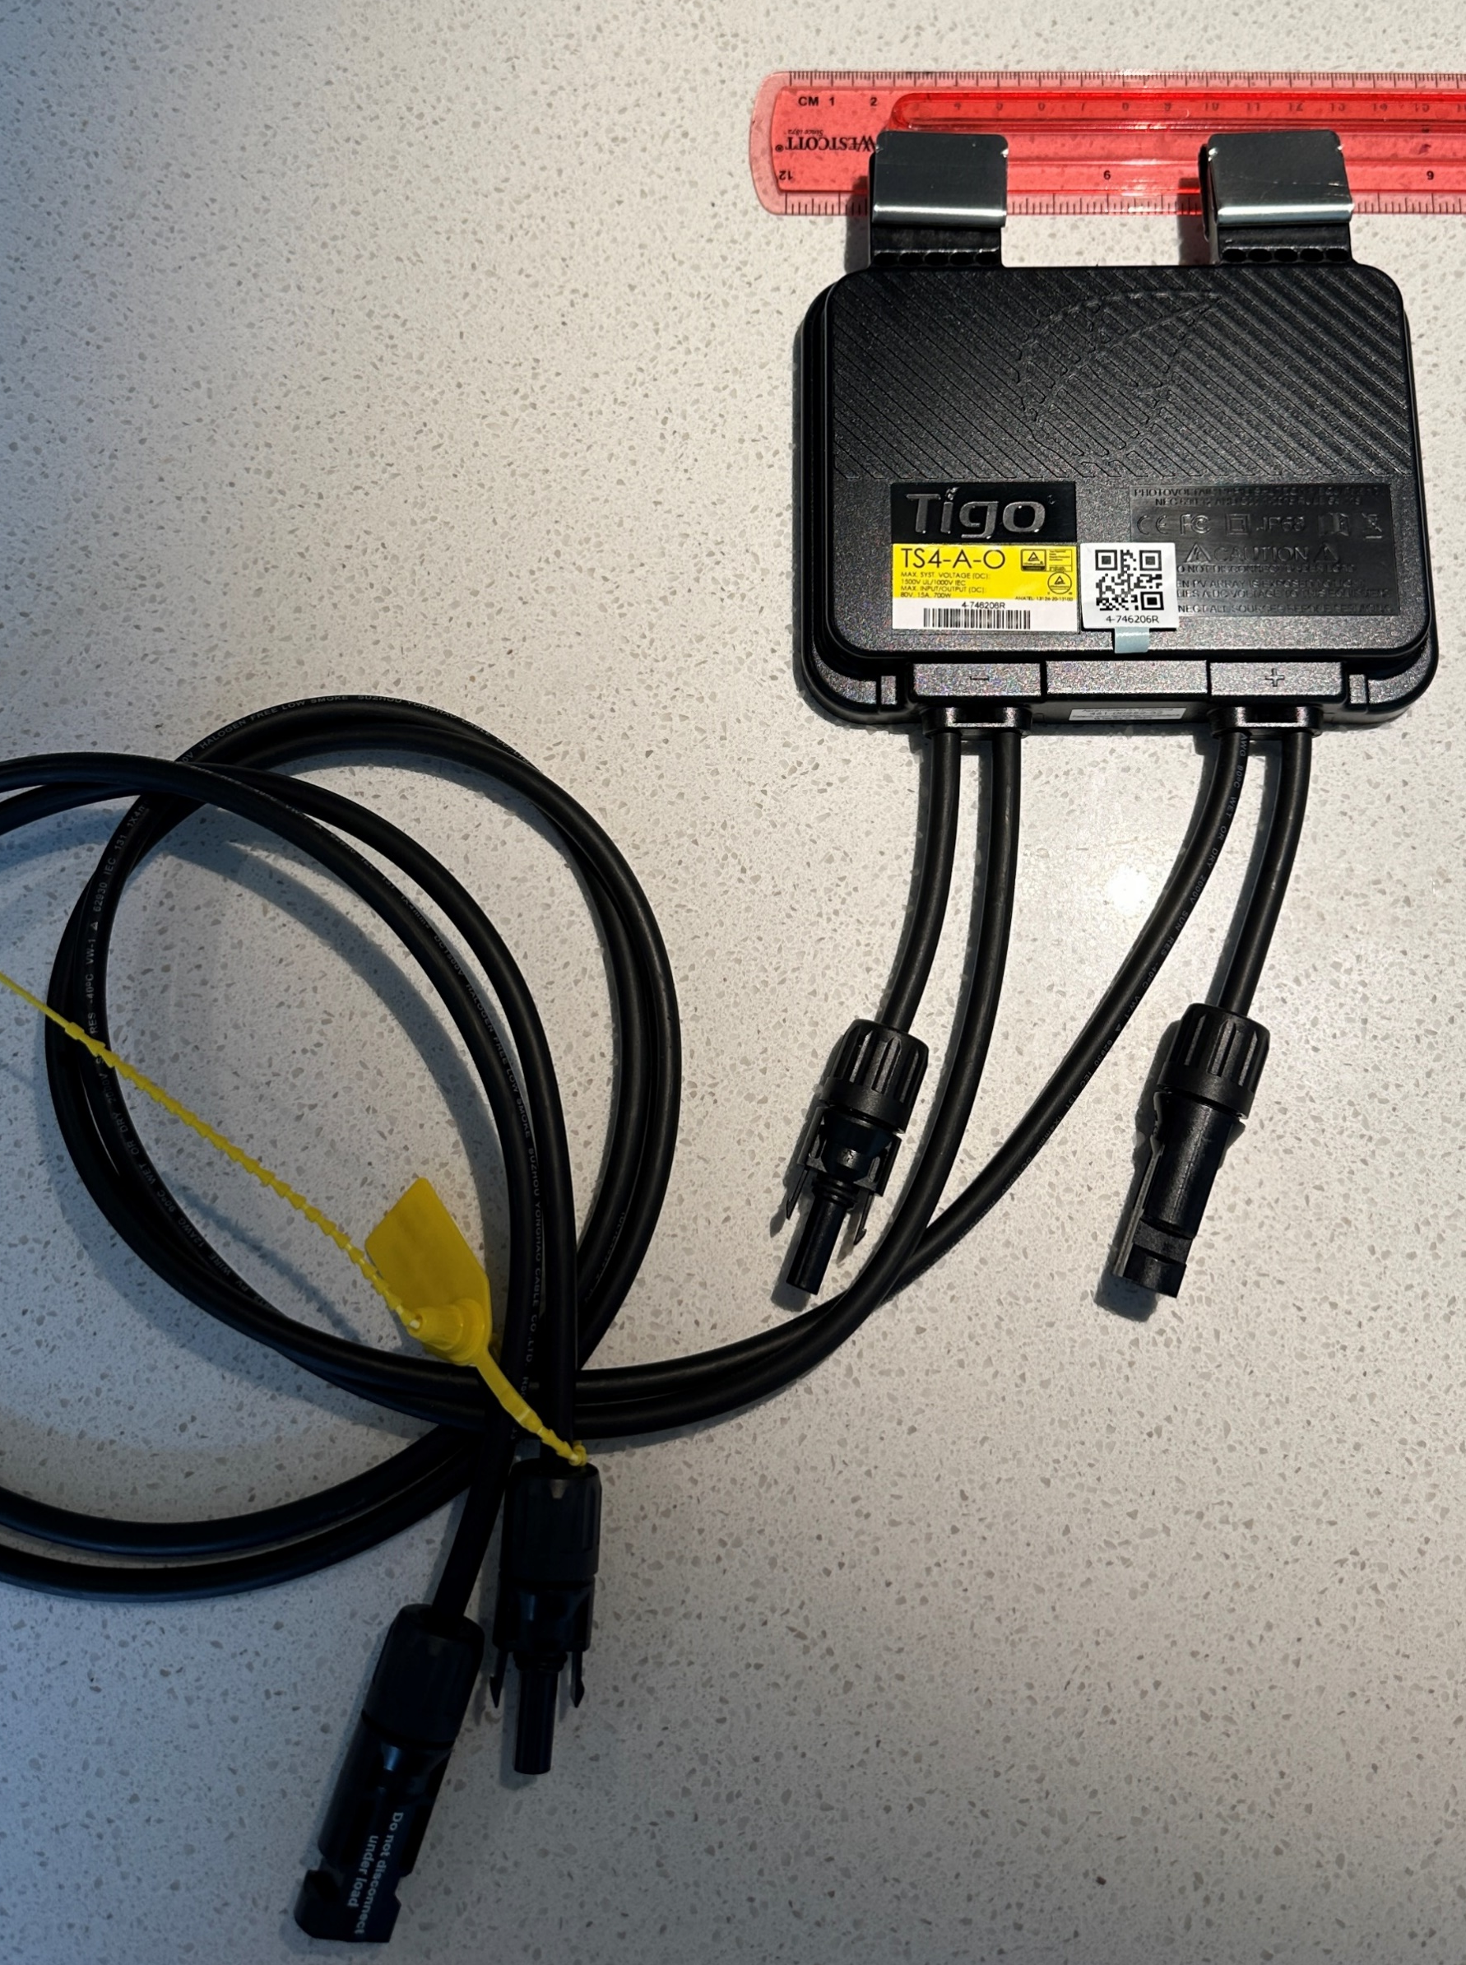
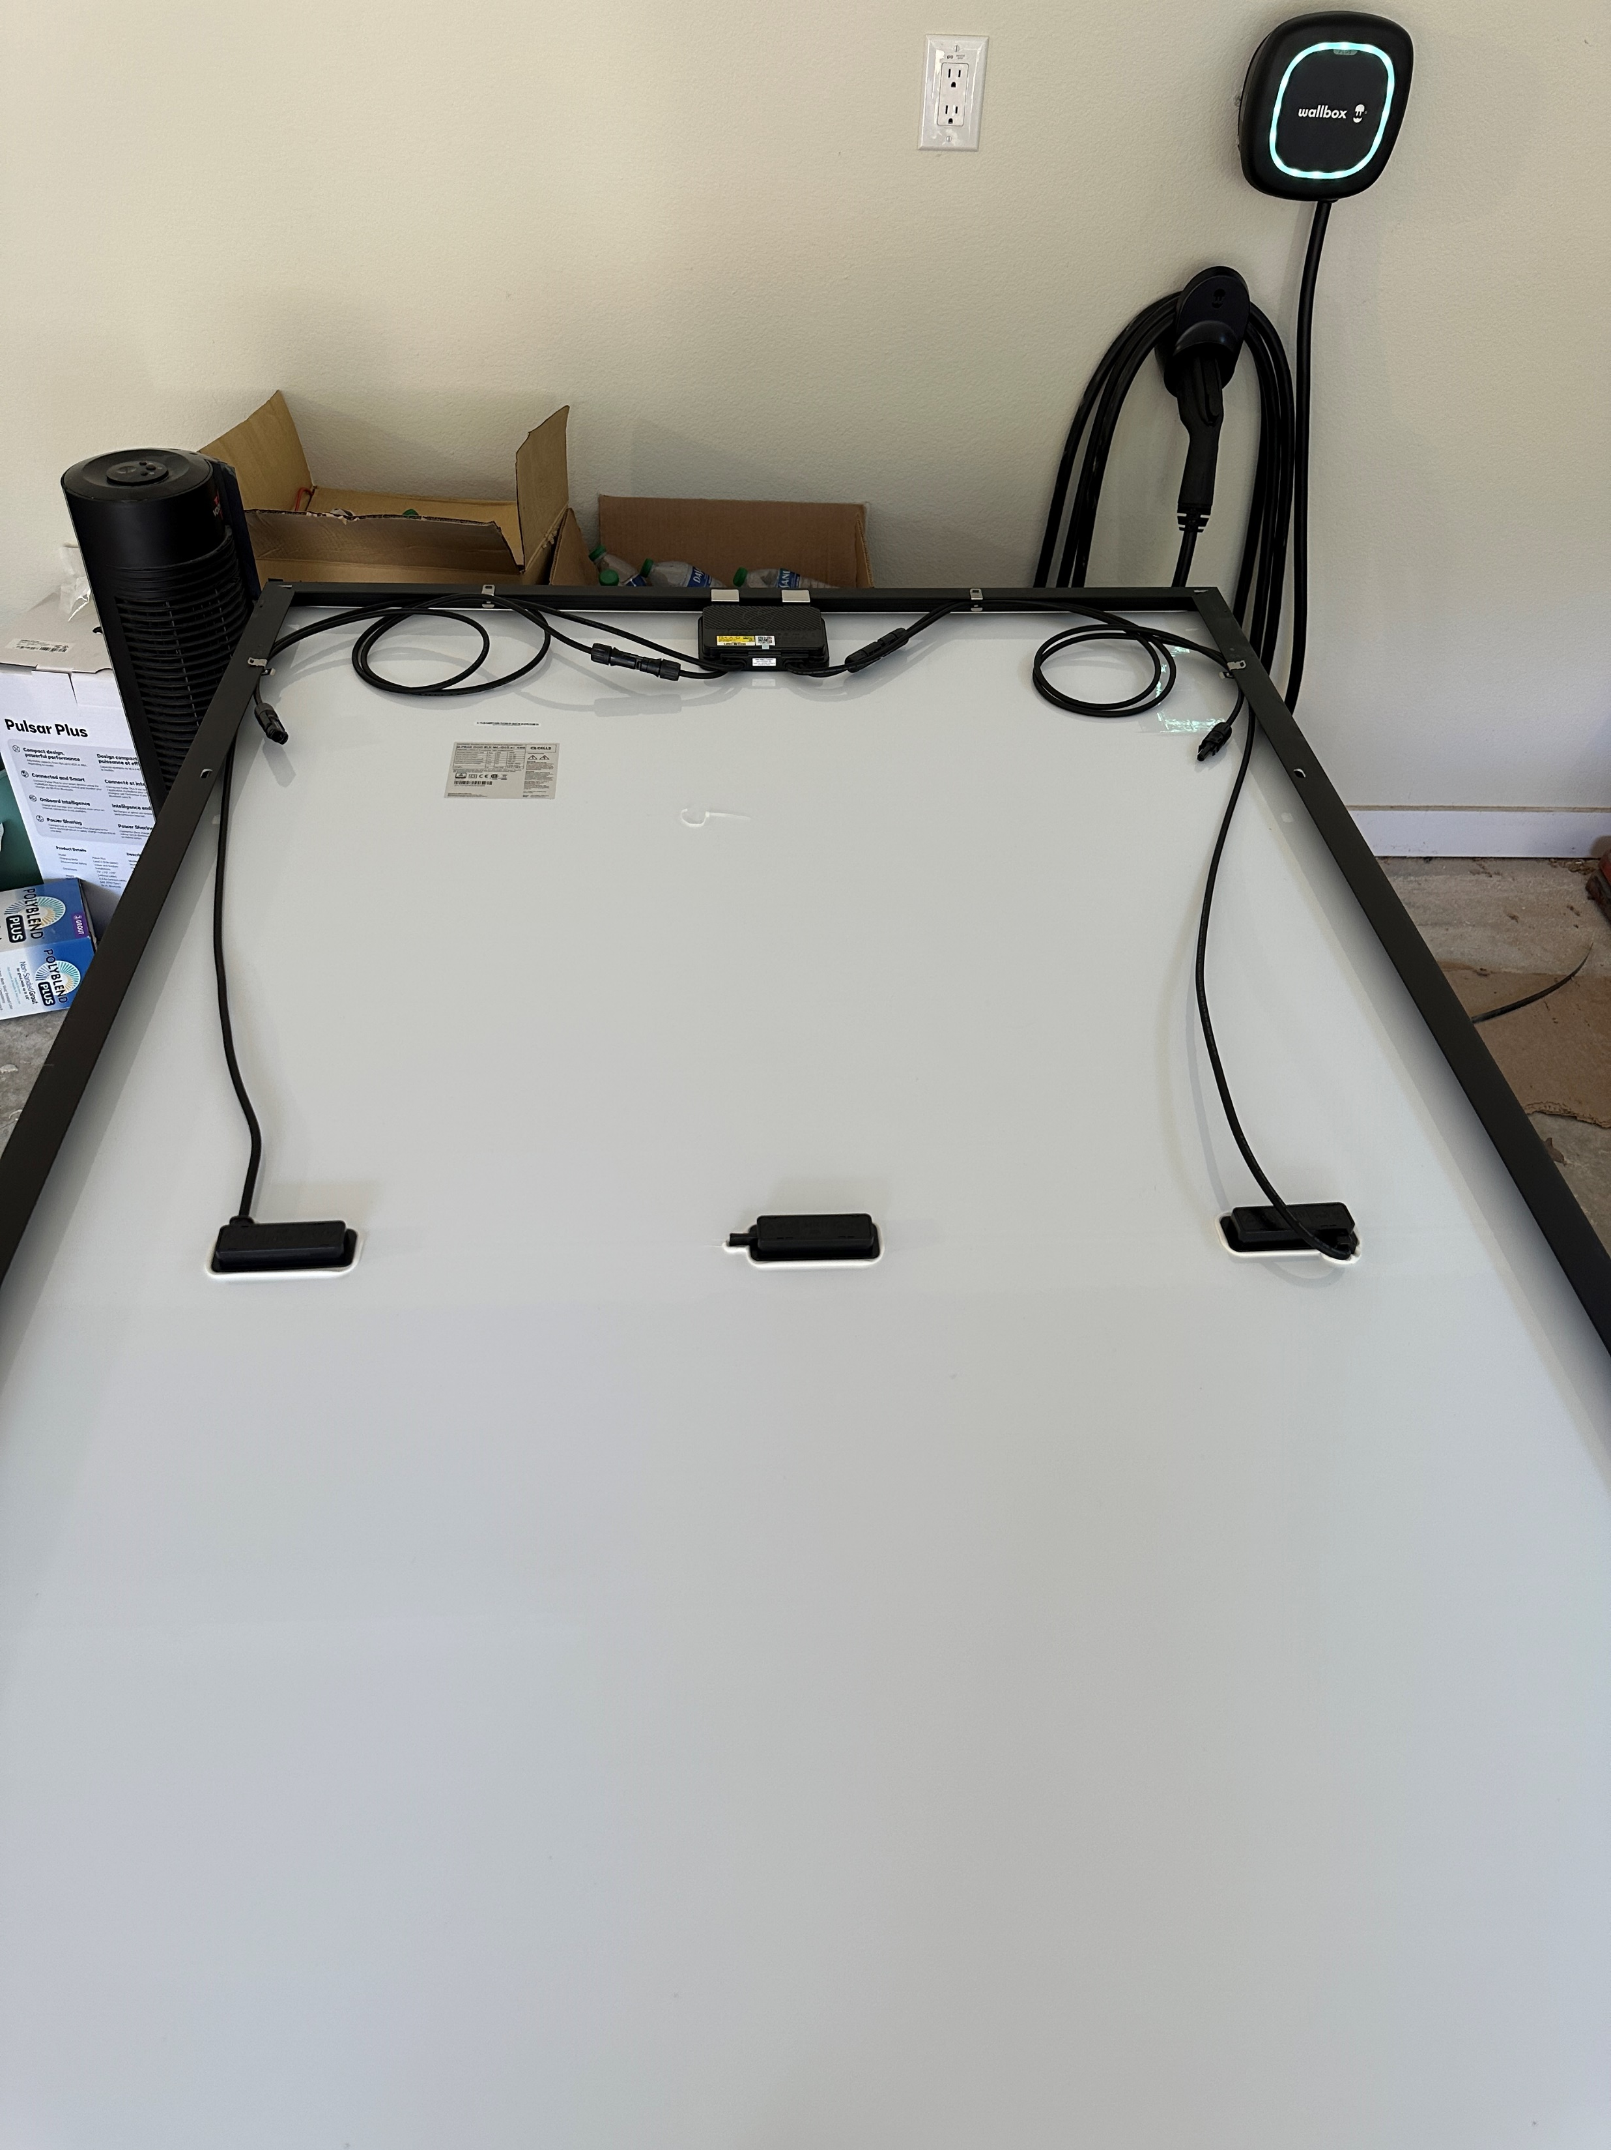

Slide 26
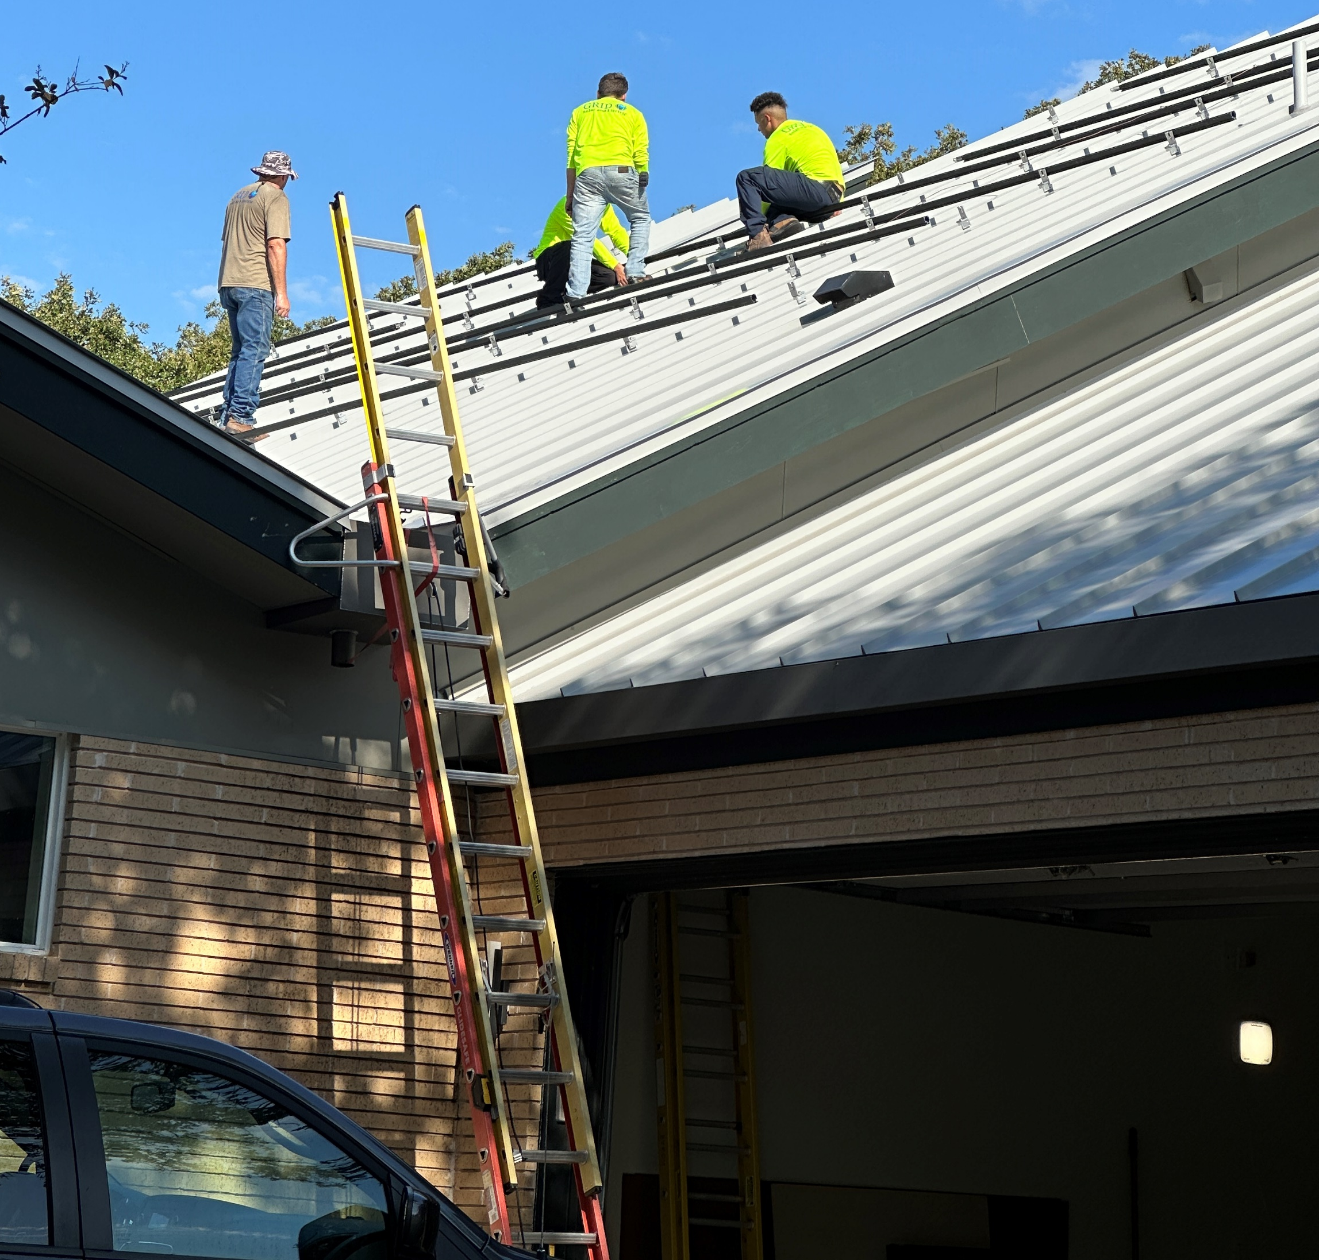
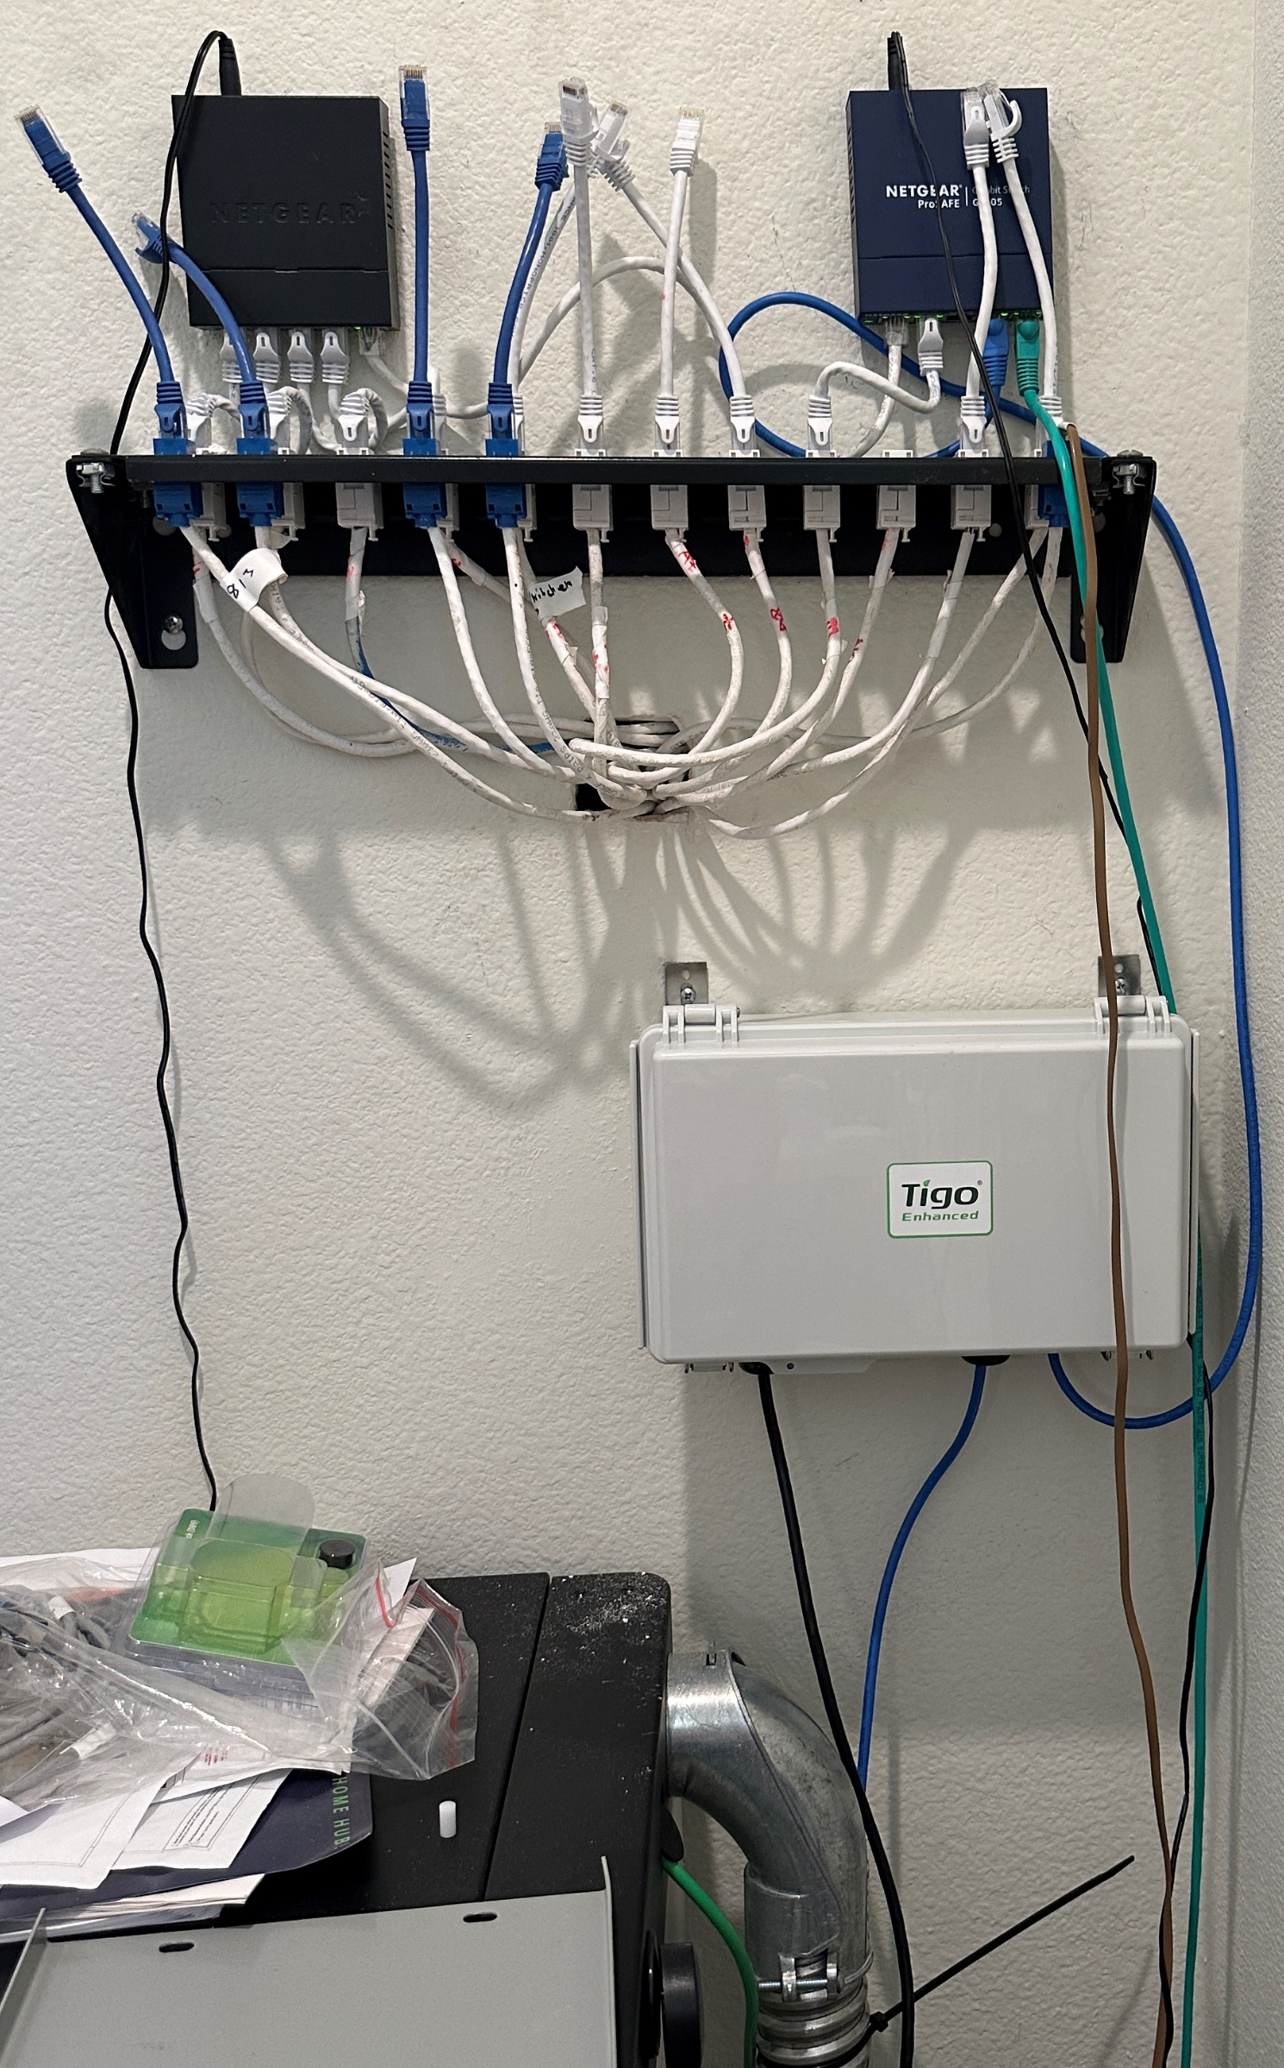
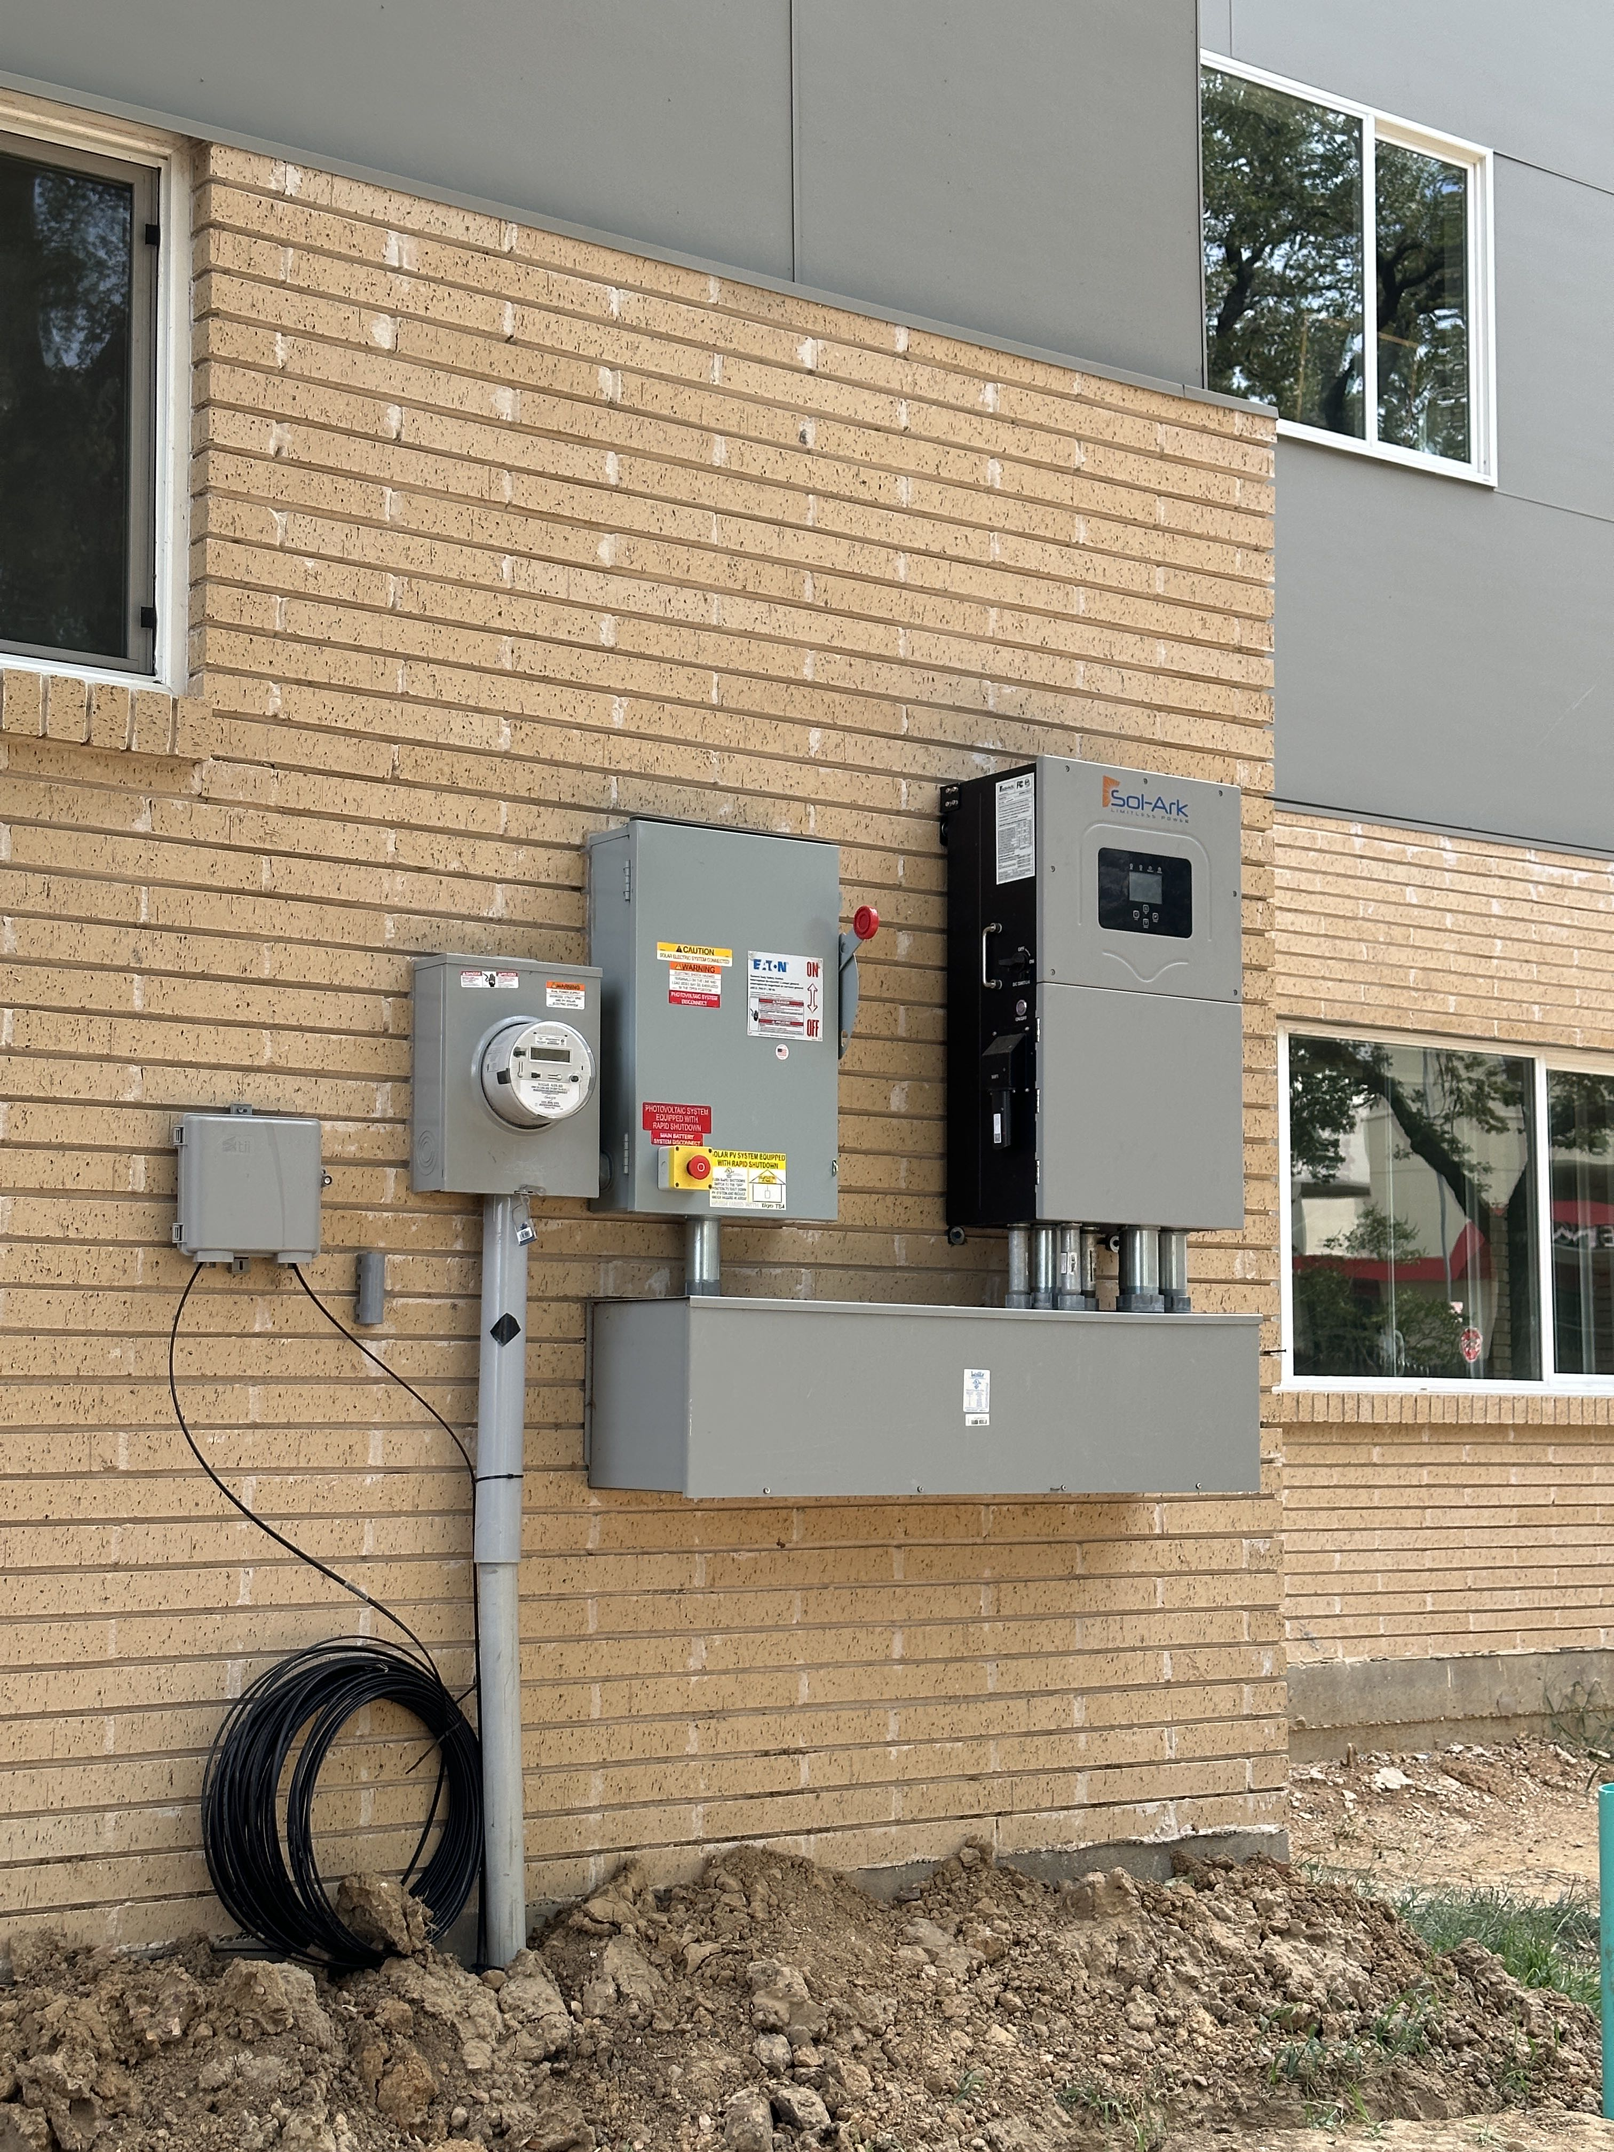

Slide 27
Conclusions
Before considering a solar power system, be sure your house is energy efficient. An energy audit may be a good investment. Old appliances, HVAC systems, and hot water heaters might be replaced with much more energy efficient new ones.
Renewable energy (from the electric grid or a home solar system) can significantly reduce your greenhouse gas footprint and improve the air quality in and around your home and the North Texas area.
Electric vehicles can be a big part in reducing pollution and can in many cases be charged using solar power from a home system.
Indoor air quality is important for our health.

